Slide 1
What’s in a Headache?
Dr Kathryn Lloyd-Thomas
Consultant Anaesthetist – Cwm Taf Morgannwg
Welsh Ob’s & Gynae Society Meeting October 2019

Slide 2
Obstetric History
22 year old G1 P0
Booking BMI 39 ( weight 98Kg)
PMH – asthma, nil else
Seen in Antenatal Clinic for routine check
?PET – Bp 140/90 150/92 140/90
Associated with Headache
Admitted @ 35+6 weeks gestation
PCR 266mg / 24hr

Slide 3
Obstetric History (2)
On Ward – Bp 124/82
Plan
CTG -normal
Steroids
Continue Observations

Slide 4
Obstetric History (3)
Next day
37 weeks
Headache persisting
No visual disturbance
Bp 140/92
Plan - Induction of Labour however pre- prostin CTG suspicious
By 14.15 – CTG pathological - for C-Section

Slide 5
Caesarean Section
Anaesthetic - Single shot spinal injection
2.5 mls Heavy Bupivicaine & 20mcg Fentanyl & 100mcg Morphine
Block tested with Ethyl Chloride
Baby Boy born - uneventful C-section –patient taken to post op LDU
In LDU - Baby BM 1.1 & Temp 34.4 - SCBU
Clexane 40mg @21.30 given

Slide 6
Headache
3 Days Post C-section mentions headache to midwives
Bp normalised post C-section (128/89)
Reviewed by Consultant and Trainee Anaesthetist 1 hour later
Headache and vomiting mentioned in notes. Patient sitting up in bed, no headache at the time, Bp stable.
Impression – not PDPH
Plan - for a review later
Midwives documented anaesthetist reviewed again – nil documented
Notes:
A 2005 prospective study of 985 parturients found that 39% of women reported headaches in the first week after delivery.^{[1]} The differential diagnoses of postpartum headache fall into two broad categories: primary headache disorders (with high prevalence) and secondary causes, which cause considerable maternal morbidity and mortality if left untreated.
What crosses our minds as we walk towards the maternity unit? Primary headache is still by far the commonest headache in the puerperium. In the largest prospective series,^{[1]} this accounted for >75% of such cases within the first seven postpartum days. Thus, although there are very important secondary causes such as cerebral venous thrombosis and meningitis, it is equally important to know details of migraine management because it can be disabling and so common.

Slide 7
Headache (2)
Patient c/o headache Day 3
Patient c/o headache Day 4
Vomited day 4 several times
Vomited day 5
Headache day 5 c/o frontal headache and shoulder pain
Day 6 review by GpST1 due to history of persistent headache / vomiting
Plan – repeat PET bloods, monitor Bp 4 hourly

Slide 8
Headache (3)
Bloods - Urate within normal limits
No further review
Bp 137/96, 132/91, 135/91, 117/84
Day 10 slight headache
Day 12 headache - Bp 121/81

Slide 9
Collapse
Patient on SCBU visiting baby early hours of the morning day 12
Patient had already c/o headache to midwife @ 01.50am
Crash call to SCBU
Patient having Tonic clonic seizure on SCBU
Self terminated
Post-ictal, confused
BM 7
Bp 115/49

Slide 10
Collapse (2)
Examination by Obs SpR - No clonus, brisk reflexes
Otherwise neurological examination NAD
Bloods: Hb 132 WCC 13.1 Plt 339 Fibrinogen 5.9
Examination by Medical SpR
No acute neurology, reflexes “intact”, fundi – NAD,
ECG - normal sinus rhythm
Imp – delayed presentation of eclampsia
For CT Brain / CT & 24hr infusion of Magnesium

Slide 11
Working diagnosis
“Stress induced seizure type activity”
(medical SpR)

Slide 12
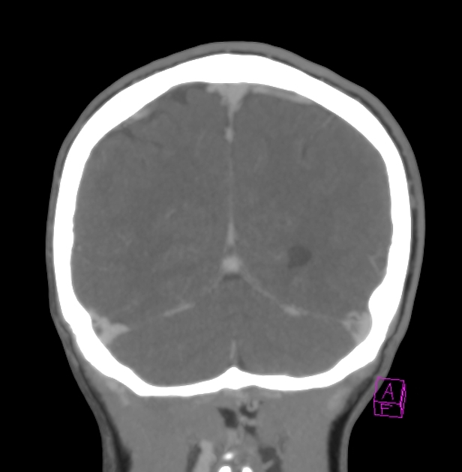
Normal CT Venogram

Slide 13
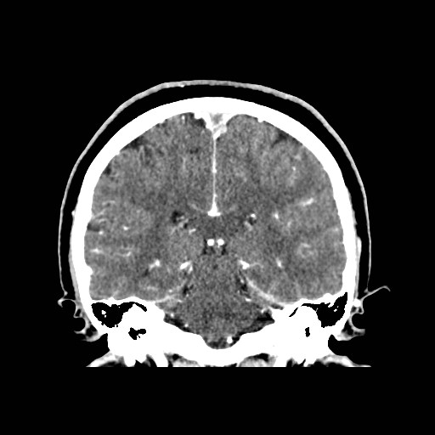
Patient’s CT Venogram
Notes:
Absence of the Delta Sign

Slide 14
CT Scan Results
On the contrast CT the anterior superior sagittal sinus and cortical veins are dilated and hyperdense raising the suspicion of thrombus, subsequently confirmed on the CT Venogram.
The appearances are consistent with Extensive Superior Sagital Sinus Thrombosis and Bilateral Cortical Venous Thrombosis.

Slide 15
Further treatment
Mg SO4 infusion stopped
Treatment - Unfractionated Heparin infusion
Warfarin therapy started
Transferred for further management under Neurologists.
Discharged home day 13 post C-section

Slide 16
Differential Diagnosis of PP Headache
Headache Aetiology | % of Postpartum headaches | Symptoms / Signs
Tension Headache | 38.3-39% | Mild- Mod headache lasting 30min- 7 days. Bilateral.
Migraine | 11- 34% | Recurrent mod- severe headache lasting 4-72 hours, often unilateral, pulsating % assoc with nausea, photophobia
Musculoskeletal | 11.3-14.7% | Mild-moderate & neck / shoulder pain
Pre-eclampsia/Eclampsia | 8.1-24% | Hypertension +/- symptoms of HELLP, bilateral, pulsating and aggravated by physical activity
PDPH | 4.7-16% | Headache within 5 days of dural puncture, worse with sitting /standing, assoc with tinnitus, nausea, photophobia

Slide 17
Differential Diagnosis of PP Headache
Headache Aetiology | % of Postpartum Headaches | Symptoms / Signs
Cortical Vein Thombosis | 3% | Nonspecific headache always present, accomp by focal neurology/ /seizure
Meningitis | 1% | Temperature, generally unwell, neck stiffness, photophobia

Slide 18
MBRRACE - Saving Mothers Lives 2018
Key Points:
Death from Thrombosis and Thromboembolism remains the leading cause of Direct Maternal Death

Slide 20
Notes:
Thrombosis and thromboembolism continue to be the leading cause of direct deaths ocuring within 42 days of the end of pregnancy, followed by death due to haemorrhage and suicide. The MMR from thrombosis and thromboembolism is the same nnow as it was in 1985-87, possible reflecting the increased prevalence of risk factors for VTE in the maternal population – such as Obesity, C-sections or interventions and older population. 39 women died between

Slide 21
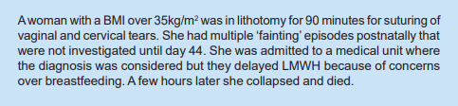
Case Report - MBBRACE

Slide 22
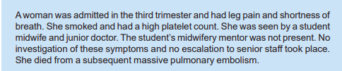
Case Report - MBBRACE

Slide 23
Case Report -MBBRACE

Slide 24
Case Report - MBBRACE

Slide 25
Case Report - MBBRACE

Slide 26
MBRRACE – Saving Mothers Lives 2014
Lessons For Anaesthesia
Subdural haematoma and cerebral venous sinus thrombosis are well recognised complications of dural puncture and pregnancy, respectively. Both should always be included in the differential diagnosis of persistent headache after dural tap or post dural puncture headache
Any Pregnant or recently pregnant woman with serious neurological symptoms/signs needs urgent appropriate early referral and / or imaging

Slide 27
Discussion
This was at least a “near miss” - still a serious case of morbidity and needing 6 -12 months Warfarin
Clexane was probably under prescribed @ 40mg OD as weight was 98kg at booking
In the future:
1. Presentation of Case to Obstetric colleagues
2. Presentation of Case to Midwifery colleagues
3. Write guidelines on persistent headache post-delivery and emphasis early input of multidisciplinary senior care /need for imaging

